Slide 1
Stock API Access using Express JS

Slide 2
Technologies use
Node JS
Express JS module
axios modules
Nodemon module
And third party provided the access key to access rest api.
Alpha Vantage
IEX Cloud
Finnhub
Polygon.io
In this project we are using Finnhub.api

Slide 3
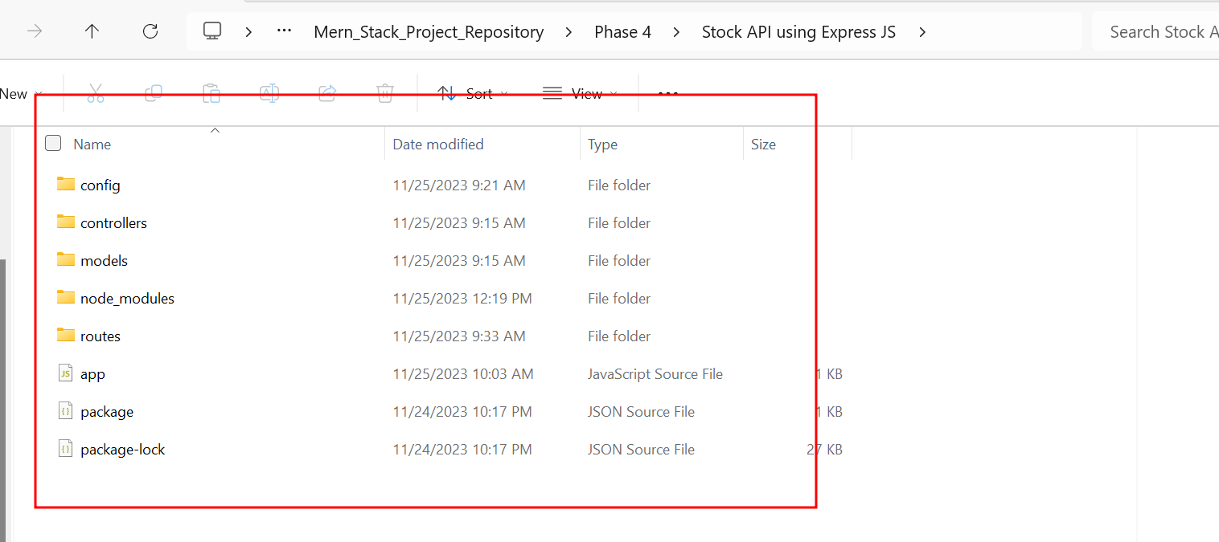
First download the project from git

Slide 4
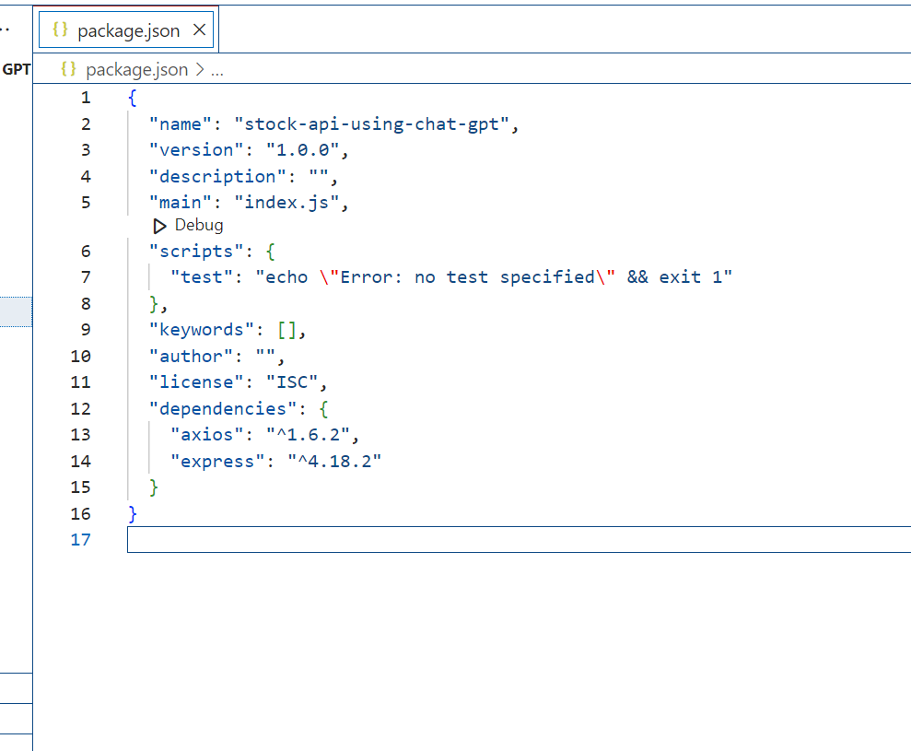
Open the package.json file

Slide 5
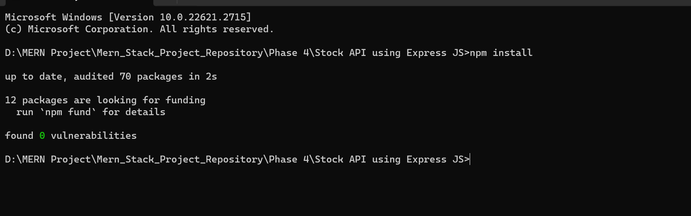
Download required node module using command as
npm install

Slide 6
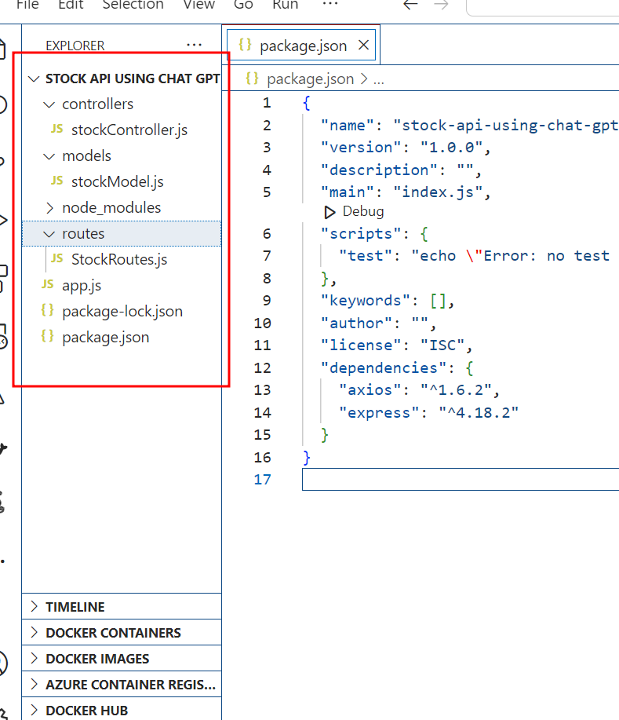
Express js project structure

Slide 7
Folder description
Model : This folder contains model file which provide the Stock axios method which interact with third party api.
Controller : This folder contains ontroller file which contains set of method which help to do the operation on collection using model files. Which takes request from router file do the operation and provide the response to client.
Router : This folder contains router file which help to map the sub path and http method base upon the request.
App.js : This file in entry of the application.

Slide 8
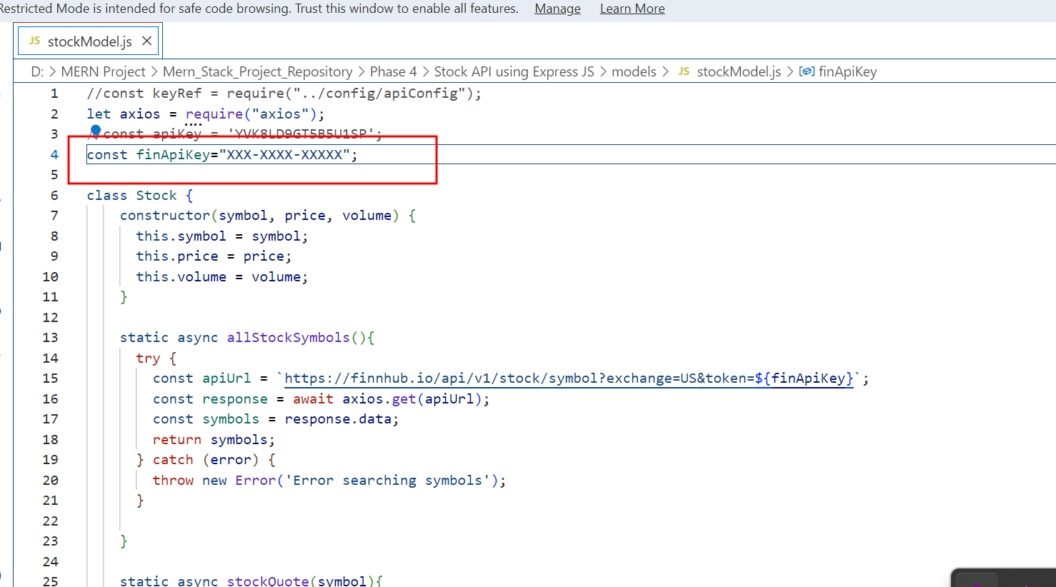
Open the stockModel.js file and create token and write it

Slide 9
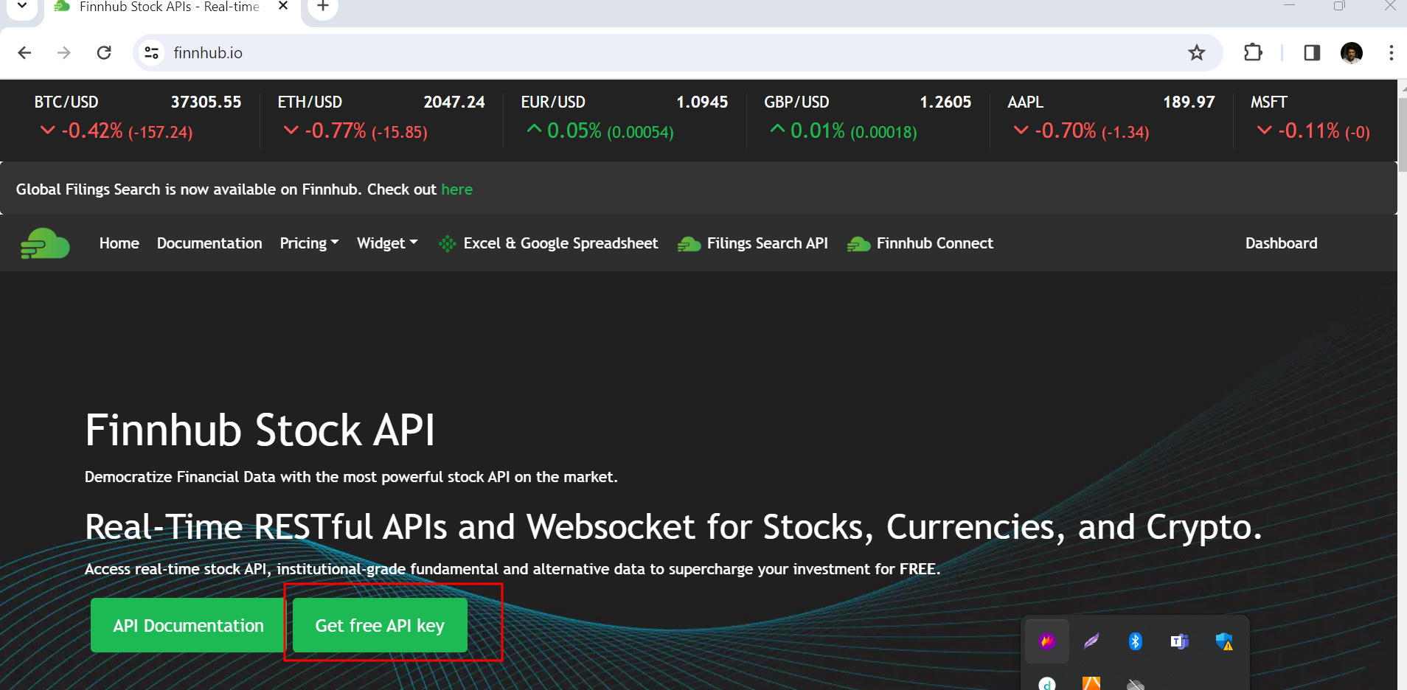
Generating token. Open the website ie https://finnhub.io/

Slide 10
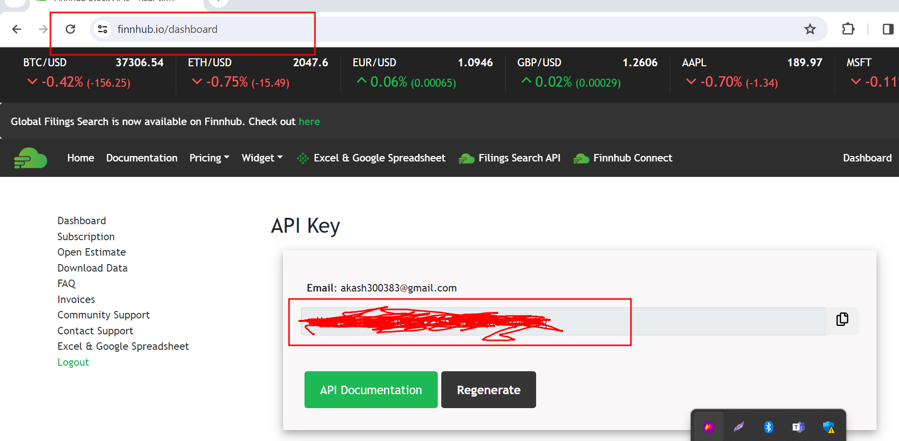
https://finnhub.io/dashboard

Slide 11
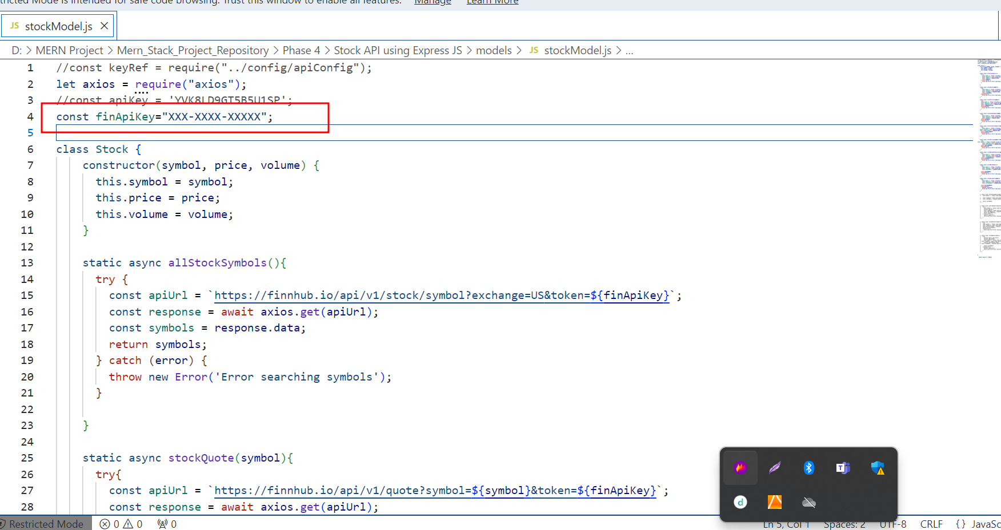
Copy and paste token in stockModel.js file in line number 4.

Slide 12
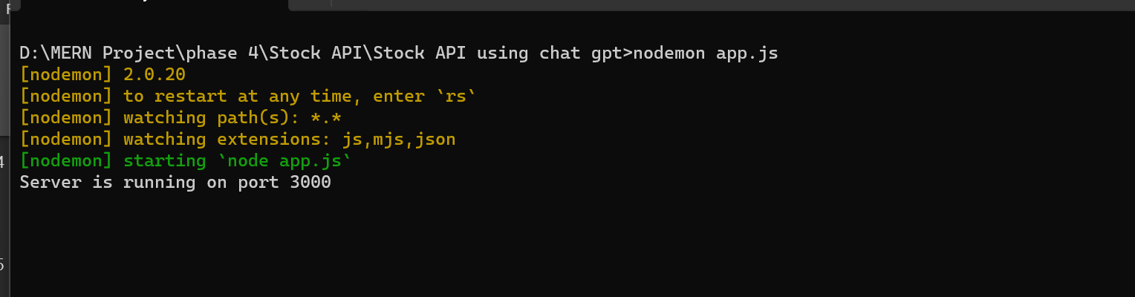
Now run the app.js file using command as
node app.js or nodemon app.js (before running this command install npm install –g nodemon

Slide 13
Now you can check all REST API using
REST client
POST Man tool
Command line client as Git
So we are using Git command prompt with CRL command to verify all rest API.

Slide 14
Stock REST API checking with Post man client

Slide 15
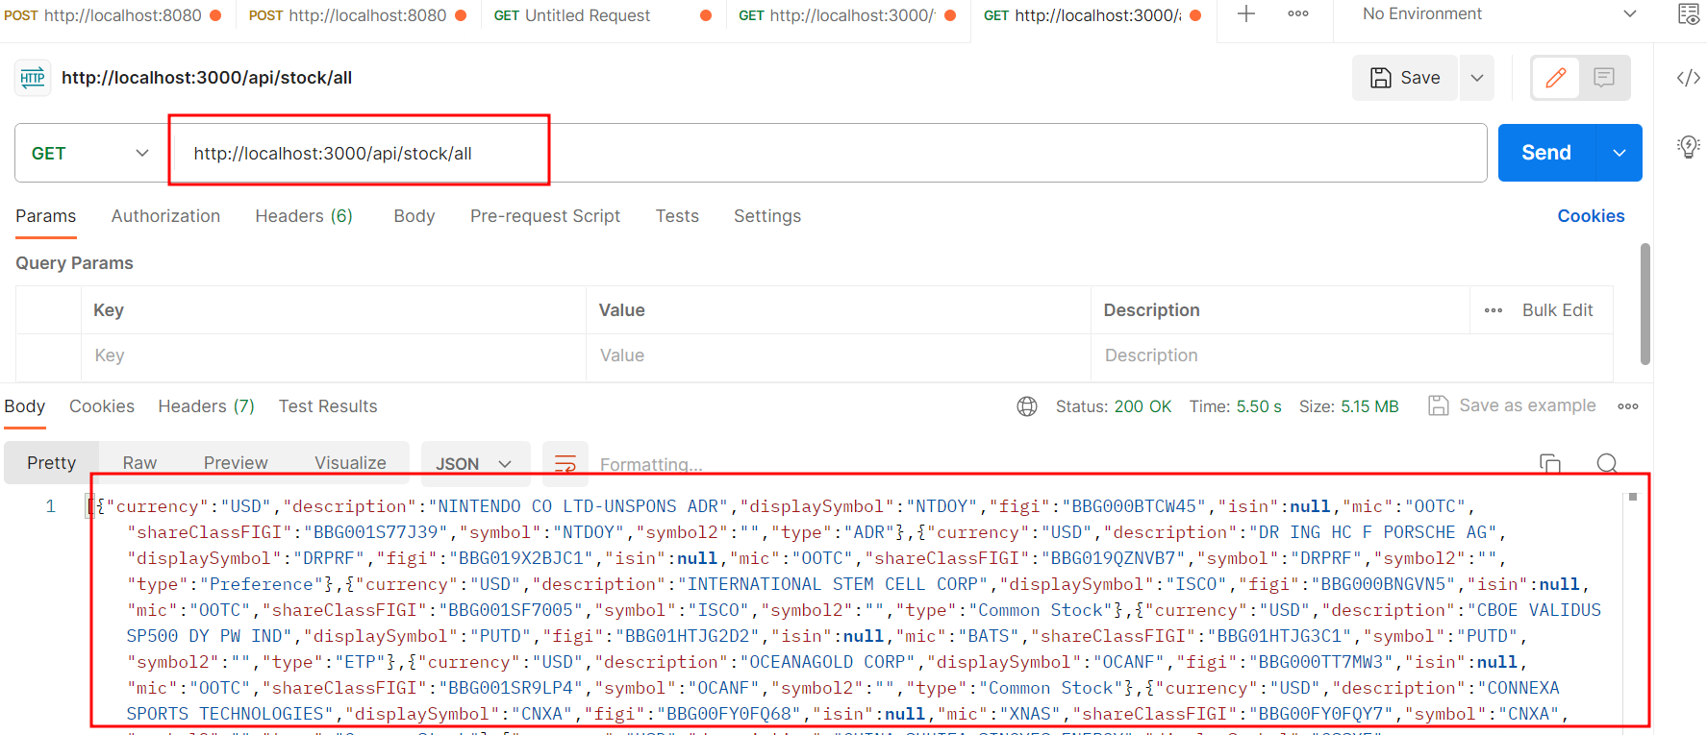
Find all stock details http://localhost:3000/api/stock/all

Slide 16
Doctor REST API
Post method : register for doctor details
http://localhost:3000/api/doctor/register
Post method : login for doctor
http://localhost:3000/api/doctor/login
Get method : view all doctors details
http://localhost:3000/api/doctor/viewDoctor
Put method : change doctor password
http://localhost:3000/api/doctor/changePassword

Slide 17
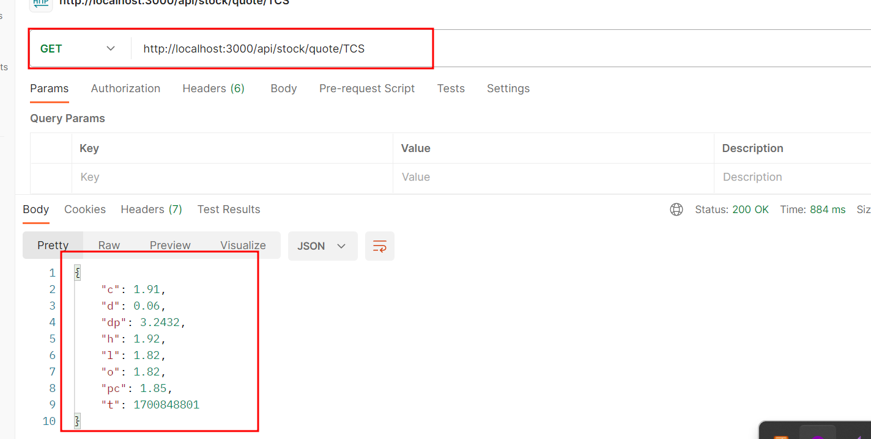
find symbol quote http://localhost:3000/api/stock/quote/TCS

Slide 18
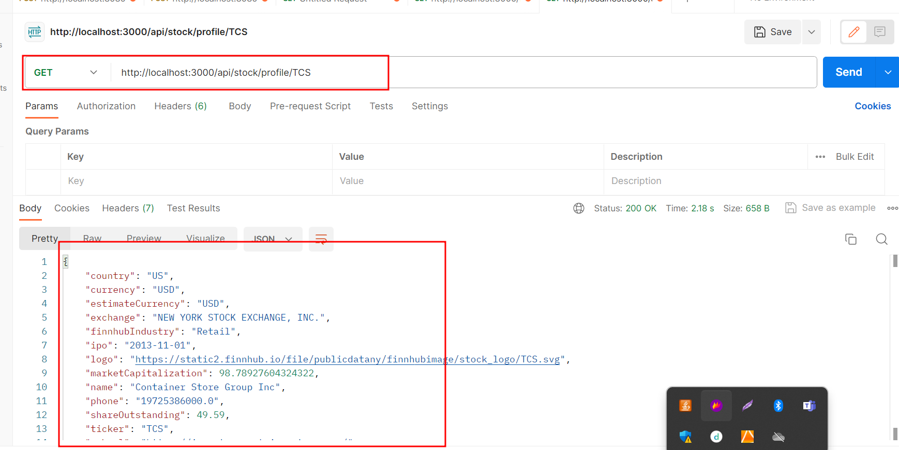
find specific stock profile details using symbol http://localhost:3000/api/stock/profile/TCS

Slide 19
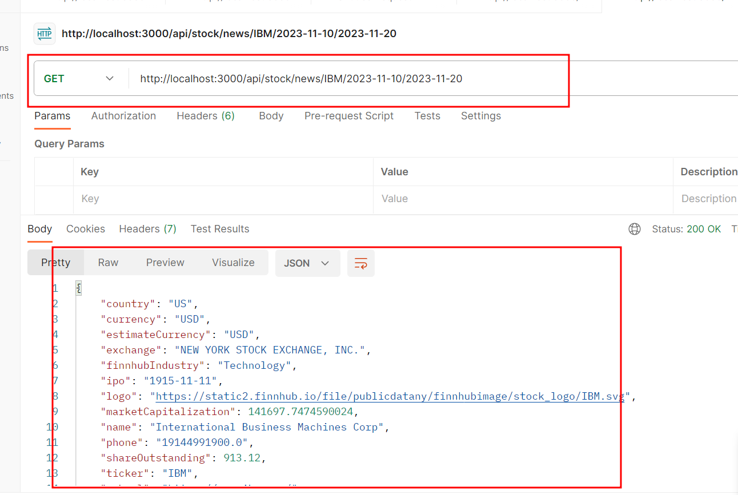
find new of specific symbol using start date and end date http://localhost:3000/api/stock/news/IBM/2023-11-10/2023-11-20

Slide 20
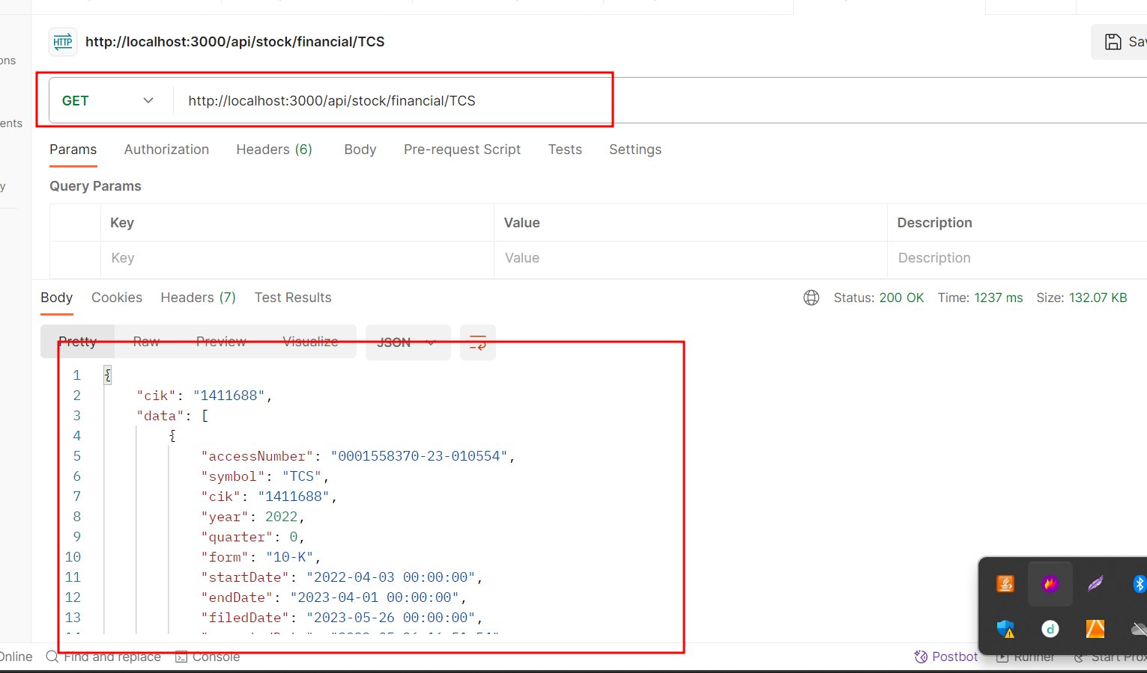
find financial stock details http://localhost:3000/api/stock/financial/TCS

Slide 21
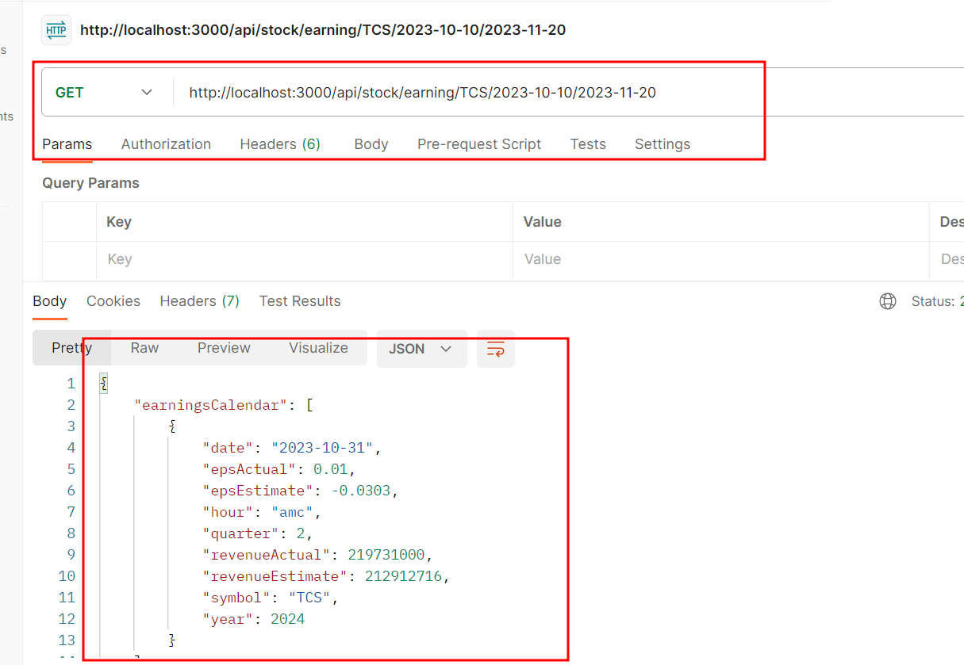
find earning for specific sock between period http://localhost:3000/api/stock/earning/TCS/2023-10-10/2023-11-20

Slide 22
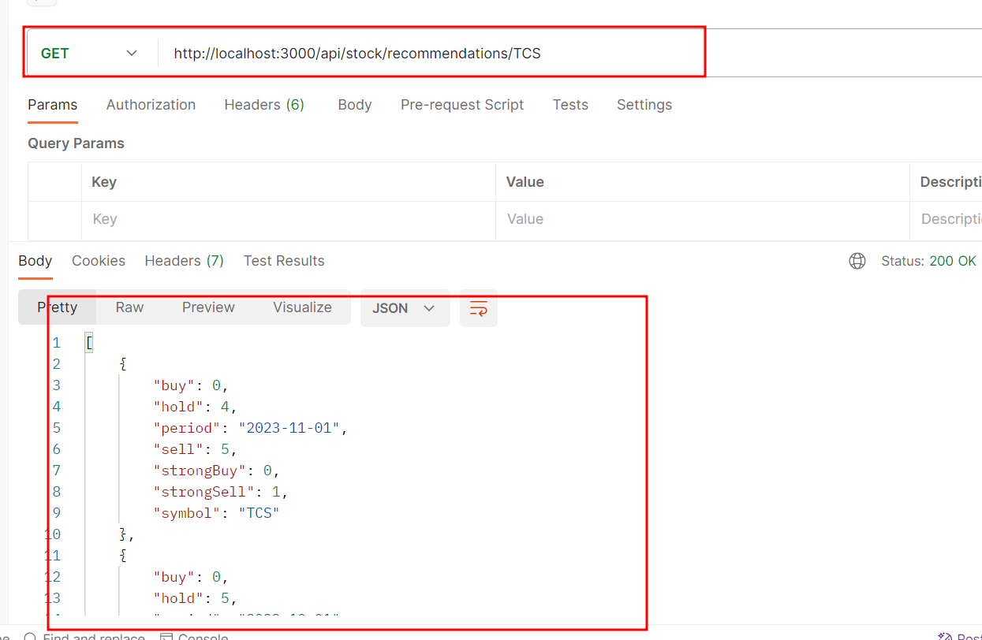
particular stock recommendations http://localhost:3000/api/stock/recommendations/TCS

Slide 23
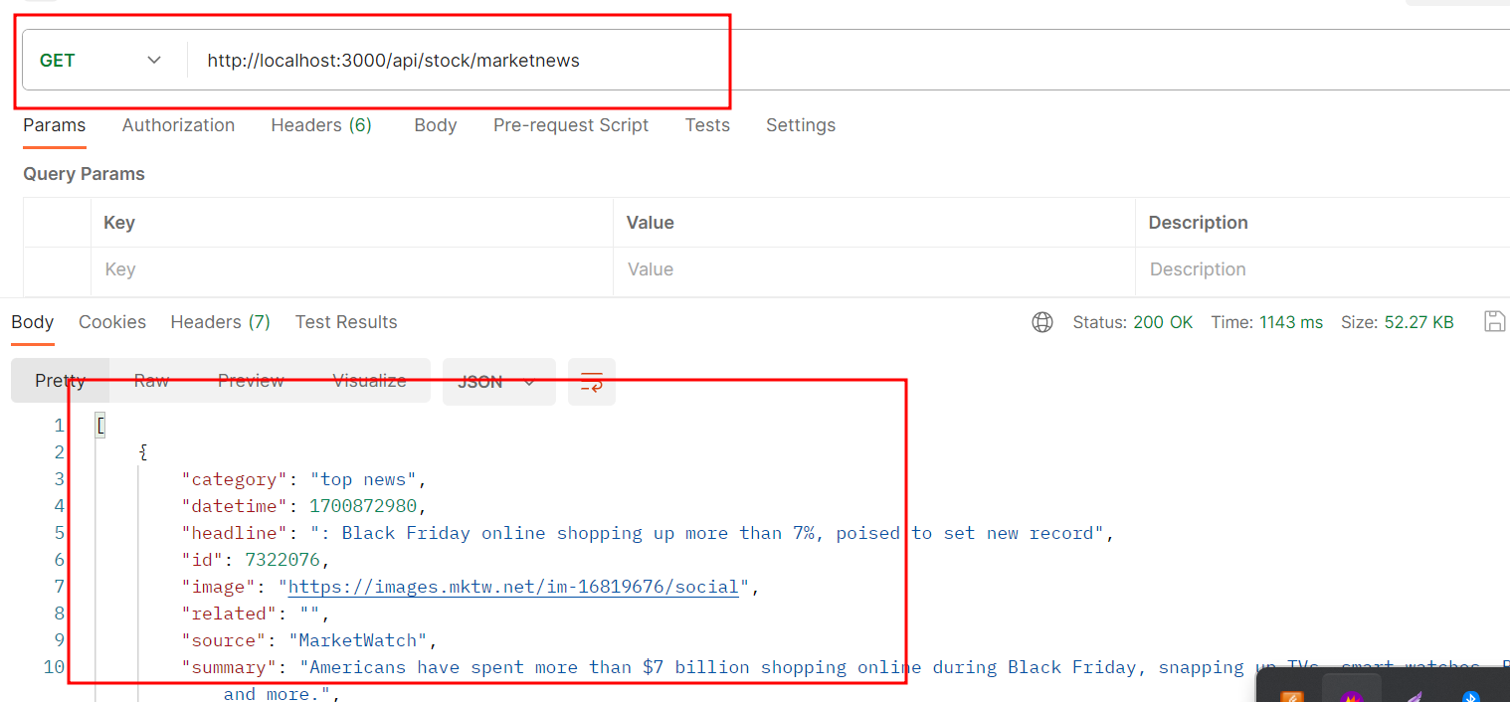
to find stock market news http://localhost:3000/api/stock/marketnews

